Slide 1
Project 1 : Analyzing Amazon Sales Data
By - Akshay Bhagwan Chaudhari
Data Analyst Intern
Batch : 01-Jan to 1-Mar 2024
Unified Mentor Pvt. Ltd.

Slide 2
Project Detail
Project Title | Analyzing Amazon Sales data
Technologies | Data Science
Domain | E-commerce
Project Difficulties level | Advanced

Slide 3
Problem Statement
Objective
Benefits
Help out to make better business decisions.
Help analyze customer trends and satisfaction, which can lead to new and better products and services.
Gives better insight of customers base.
Helps in easy flow for managing resources.
Develop a Report by Extracting, Transforming and Loading of data which contains Sales trend with respect to Year, Month, Quarter and find Some relationships through data to understand and Analyze the Facts.
Sales management has gained importance to meet increasing competition and the need for improved methods of distribution to reduce cost and to increase profits. Sales management today is the most important function in a commercial and business enterprise.

Slide 4
Quick Insight
Selling Analysis
﻿A quick insight for 2010 to 2017 amazon sales.
137.35M
Total Sales
513K
Sales Quantity
44.17M
Total Profit
83.72K
Highest Sales by Product
(Cosmetics)
24.57K
Highest Sales by Country
(Sao Tome Principe)

Slide 5
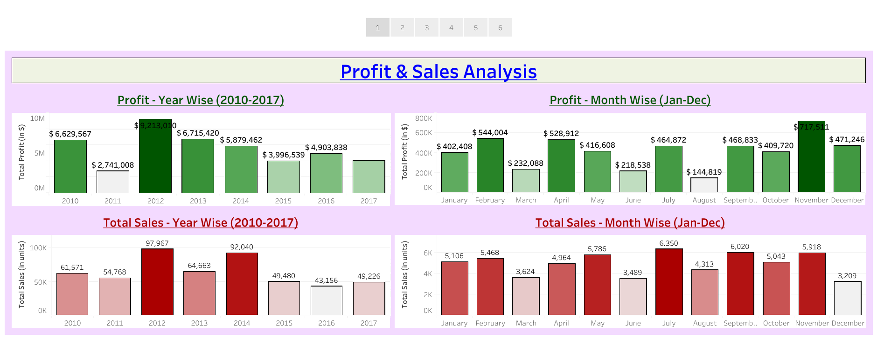
Profit & Sales Analysis

Slide 6
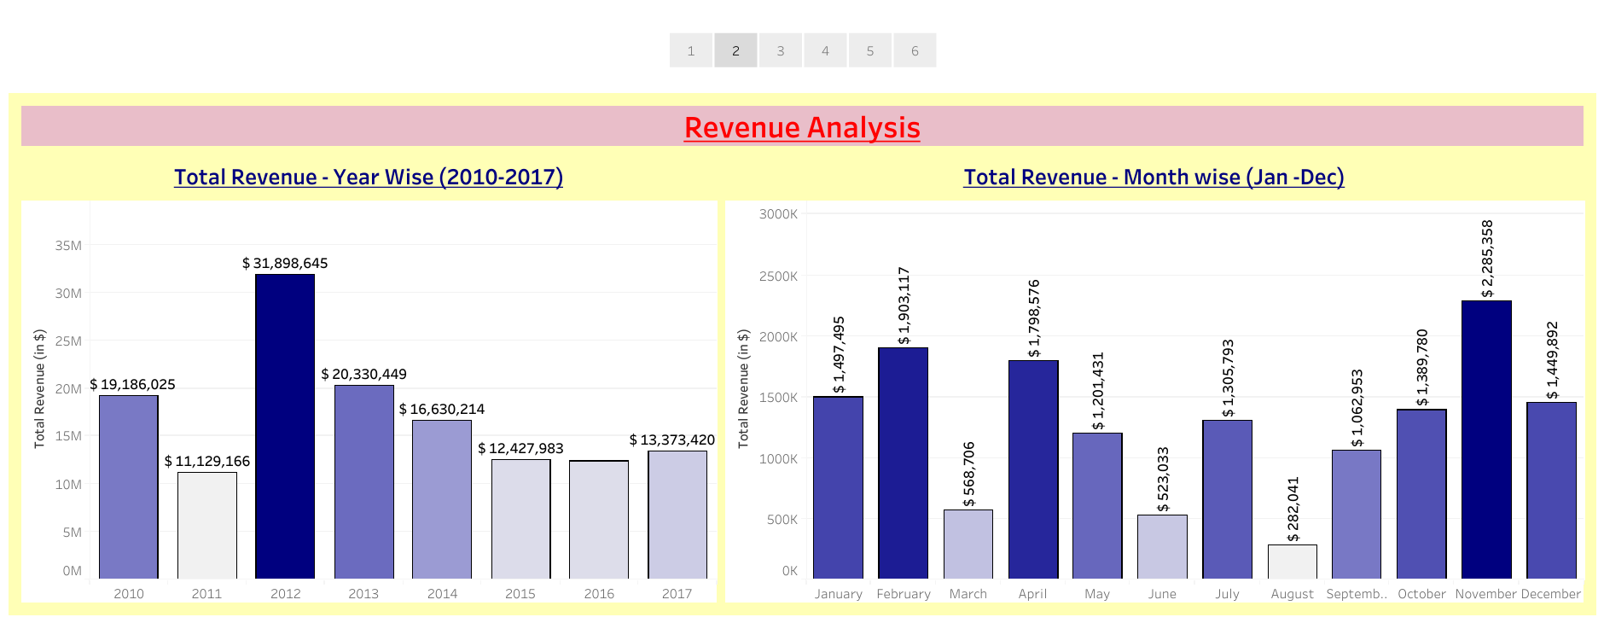
Total Revenue Analysis

Slide 7
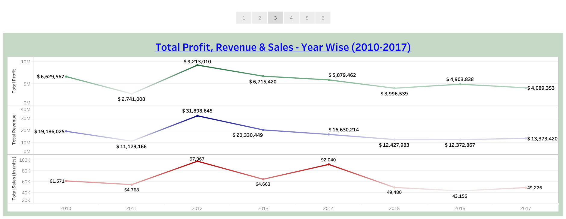
Total Profit, Revenue & Sales Analysis - Year Wise (2010 - 2017)

Slide 8
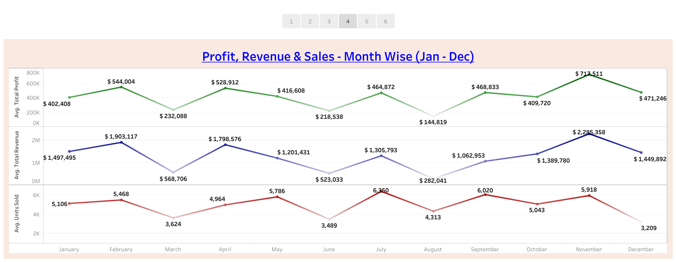
Profit, Revenue & Sales Analysis - Month Wise (Jan - Dec)

Slide 9
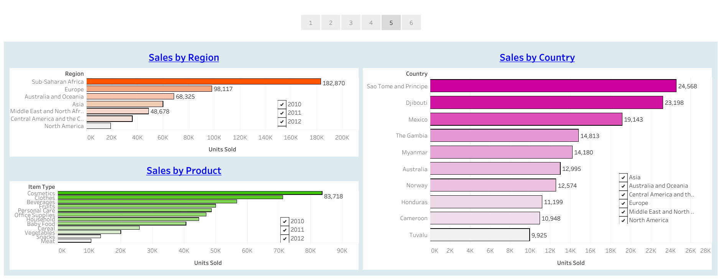
Selling by Region, Country, Product

Slide 10
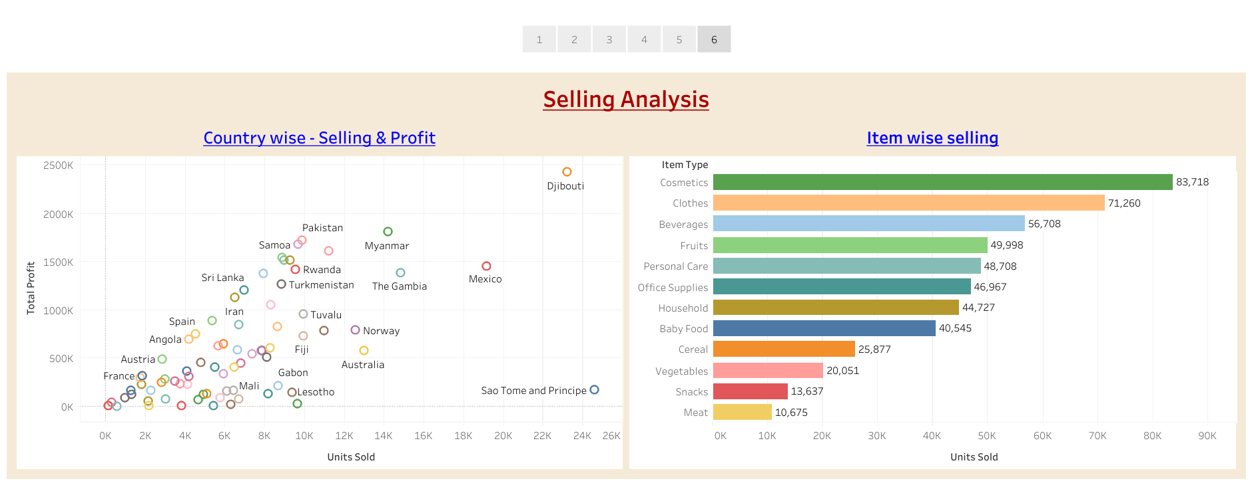
Selling Analysis

Slide 11
Conclusion
1. 2012 had the Highest Revenue at 31.90 M, followed by 2013 at 20.33 M and the Least Revenue in 2011 at 11.13 M.
2. If we observe the monthly insights from 2010 to 2017, the sales are at their peak in July, September, and November and are low in December, June & March. Amazon can come up with some good discounts and offers to generate high revenue.
3. The sales for the Sao Tome Principe , Djibouti are highest among all countries and lowest in Tuvalu.
4. The Cosmetics and the Clothes are the highest selling products in domestic and international markets.
5. In average Amazon generated the highest revenue in the month of November, February and April.

Slide 12
THANK YOU

